Slide 1

Anomaly Detection in Credit Card Transactions using Power BI
By Aditi Agarwal

Slide 2
INDEX
Index number | Contents
01 | Introduction
02 | Overview of fraud transactions
03 | Consolidated dashboard
04 | Key findings
05 | Charts and graphs
06 | Recommendations

Slide 3
INTRODUCTION
In this presentation, we will briefly explain the importance of anomaly detection in credit card transactions revealing patterns that are crucial to detect the deviations from normal behavior, helping to identify potentially fraudulent transactions in real-time.
Anomaly detection is crucial for detecting fraudulent activities and ensuring the security of credit card transactions. provides insights into transaction patterns and identifies potential anomalies.
The goal is to explain common techniques used for anomaly detection, such as statistical methods, machine learning algorithms, and neural networks.

Slide 4
Project Overview
Fraud Type
Time Trends
Identifying Fraudsters
Explore and analyze fraud transactions across different payment types CASH-IN, CASH-OUT, DEBIT, PAYMENT and TRANSFER.
Investigate fraud amounts increasing over time to identify unusual spike and Behaviour.
Examine the customers who started the transaction and have highest fraudulent transaction amount.

Slide 5
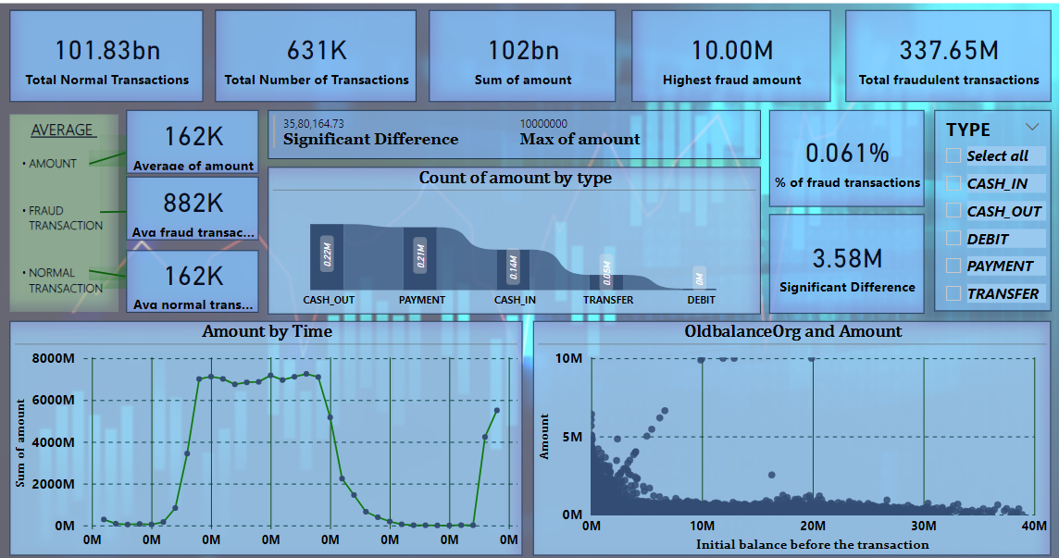
A broader look…

Slide 6
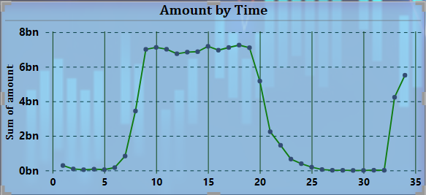
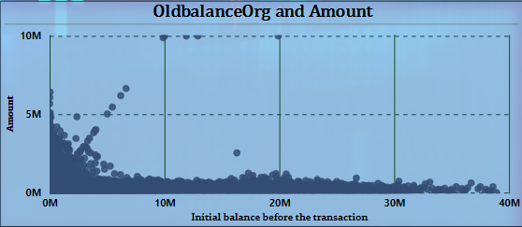
Key Findings
Sum of amount(local currenty) was recorded highest at 15 steps i.e. 15 hours.
Graph shows relationship between 'oldbalanceOrg' and 'amount' columns. normal transactions typically fell between $6,117.85 and $674,086.23. In contrast, fraudulent transactions were observed in the higher range of $854,286.86 to $910,504.14.

Slide 7
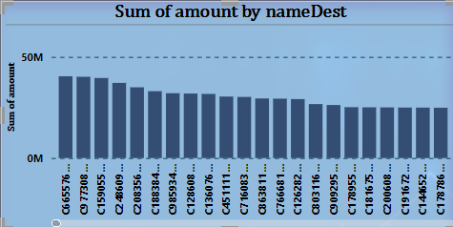
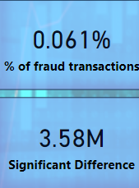
﻿At 40439560, C665576141 had the highest Sum of amount and was 40,43,95,60,280.00% higher than M1481535853, which had the lowest Sum of amount at 0.﻿﻿ ﻿
We can see a difference of 3.58 Million is the difference amount ([Highest fraud amount]-[Highest Normal transaction amount])
The percentage of total fraud transactions is 0.061%

Slide 8
Recommendations
We can see that most of the fraudulent transactions( mode –Transfer and cashout) were made by the fraudulent agents inside the simulation and the agents aims to profit by taking control of customers accounts & try to empty the funds by transferring to another account and then cashing out of the system. So, it will be recommended to keep a check on data privacy and security regulations.
Implement a system for ongoing monitoring of transaction data to detect new anomalies as they occur.
Set up alerts or notifications within Power BI to notify stakeholders in real-time when suspicious activities are detected.
Integrate the anomaly detection system with existing fraud management systems or workflows to streamline decision-making processes and improve response times to detected anomalies.
Implement robust data security measures to safeguard against unauthorized access or data breaches, including encryption, access controls, and audit trails.

Slide 9
THANK YOU

